Slide 1
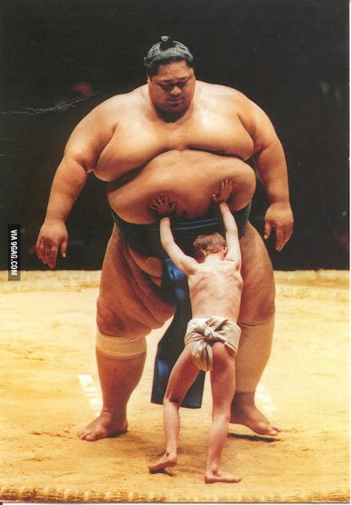
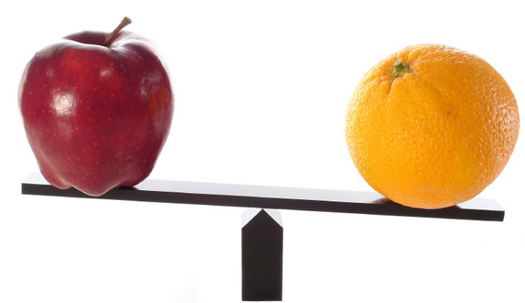
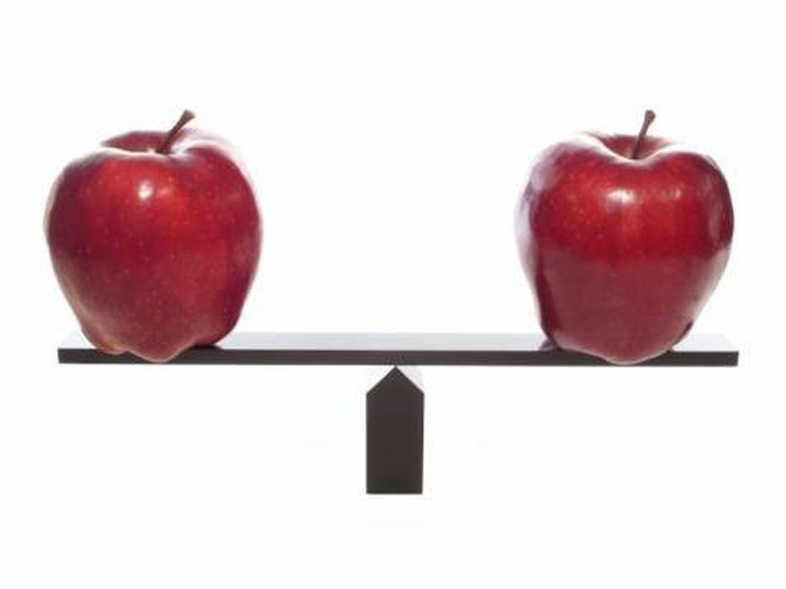
Why Scaling

Slide 2



Standardization
Standardization replaces the values by their Z scores.
Range most freq: [-3:3]
Full Range : [-4:4]

Slide 3
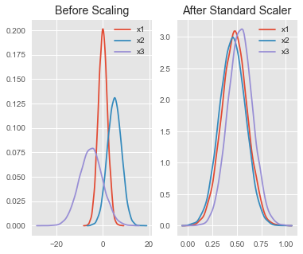

Slide 4




Slide 5


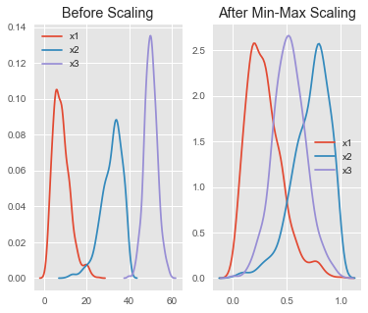


Slide 6

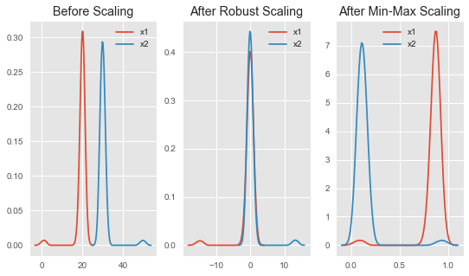

Slide 7


Slide 8




Slide 9



Slide 10
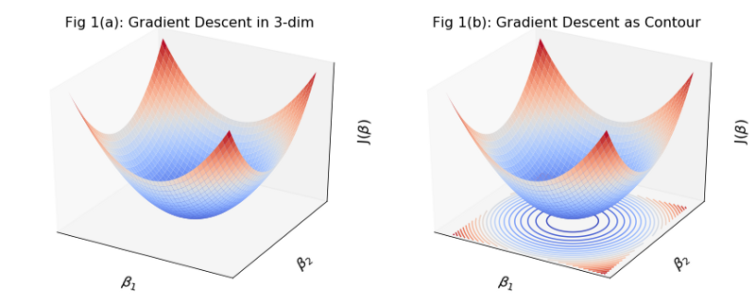
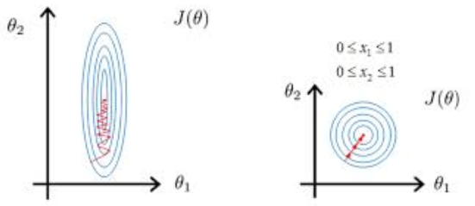

Slide 11

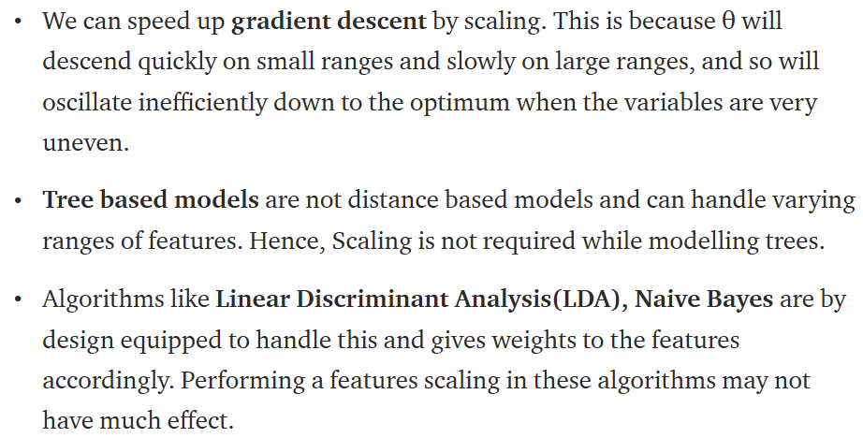

Slide 12
feature scaling is necessary while using ridge and lasso regression; basically using regularization parameters(L2 and L1 norm). Standard least squares doesn’t often require them but while using regularization with Standard least squares, scaling is necessary.

Slide 13


Slide 14
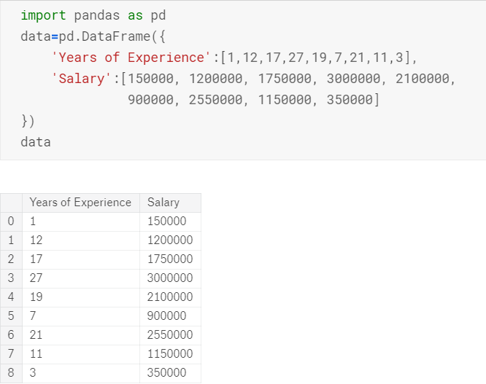

Slide 15
